Slide 1
Project Phoenix: Abandoned Cart Fix
October 28, 2025

Slide 2
The Crisis & The Solution
Abandonment is NOT about Price Shock—It's a Friction Problem.
100% of abandonment happens in under 2 minutes, and the single largest group leaves with only 1–2 items. The checkout experience is broken.
The Ask: Approve immediate funding to Audit the Payment and Shipping Integration.

Slide 3
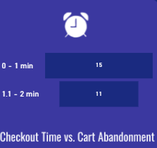
Proof of Friction (The Time Data)
100% of Customers Abandon in the First 2 Minutes.
If this were Price Shock, the time spent would be much longer (5-10 minutes). They are hitting a surprise barrier immediately.
Checkout Time Segment | Abandonment Rate
0–1 Minute | 57.69%
1.1–2 Minutes | 42.31%

Slide 4
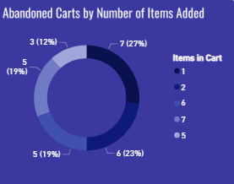
Proof of No Price Shock (The Item Data)
Half of All Abandonment is for Low-Value Carts (1–2 Items)
The single largest groups leaving have only 1 or 2 items. The total price is clearly not the problem. This reinforces the diagnosis that the core issue is payment/shipping friction.
Item Count in Abandoned Cart | Abandonment Rate
1 Item | 26.92%
2 Items | 23.08%

Slide 5
Action Plan & Next Steps
Three Quick Wins to Fix Checkout Friction
1: Payment Integration (Priority Fix)
Action: Investigate and integrate local, popular, and convenient payment methods (e.g., local accounts) to remove the payment wall.
2: Price Transparency
Action: Display clear, upfront shipping costs before the customer enters their personal address to prevent the "surprise fee" exit.
3: Recovery Program (Quick Win)
Action: Launch the automated 4-hour cart reminder to recover sales lost while we fix the underlying technical issues.

